Slide 1

DIVINE GRACE COLLEGE OF ARTS, SCIENCE AND TECHNOLOGY
(DGCAST) — GAROUA | GEOGRAPHY DEPARTMENT
UPPER SIXTH ARTS — ENVIRONMENT AND DEVELOPMENT — LESSON 14
Aid and Interdependence
Mr KAMDEM EMMANUEL
Geography Teacher — PLEG
Academic Year 2026 / 2027
Notes:
Good morning, class. Today we study Lesson 14: Aid and Interdependence.

Slide 2
GEOGRAPHY — UPPER SIXTH ARTS
CLASS INFO
Class, Chapter & Duration
Class | Upper Sixth Arts
Chapter | Module 7: Understanding and managing contemporary environmental and development issues
Duration | 2 periods (2 × 50 minutes)
2026 / 2027
DGCAST GAROUA — GEOGRAPHY DEPARTMENT
Mr KAMDEM E. | 2

Slide 3
GEOGRAPHY — UPPER SIXTH ARTS
IDENTIFICATION
Lesson Identification
Topic | Current Development Issues
Sub-topic | Trade and Cooperation
Lesson | Lesson 14: Aid and Interdependence
Notions / Concepts | Aid, bilateral aid, multilateral aid, NGO, tied aid, interdependence.
Syllabus focus | Meaning of foreign aid; types (official, voluntary, direct, indirect); donors and recipients; appraisal (arguments for and against).
Competence | Learners are able to classify aid and evaluate its effects.
2026 / 2027
DGCAST GAROUA — GEOGRAPHY DEPARTMENT
Mr KAMDEM E. | 3

Slide 4
GEOGRAPHY — UPPER SIXTH ARTS
OBJECTIVES
Learning Objectives
By the end of the lesson, the learner should be able to:
Define aid and classify its types.
Identify donors and recipients.
Evaluate arguments for and against aid.
2026 / 2027
DGCAST GAROUA — GEOGRAPHY DEPARTMENT
Mr KAMDEM E. | 4

Slide 5
GEOGRAPHY — UPPER SIXTH ARTS
RECALL
Recall
Some schools and wells were built with foreign help.
Countries depend on each other.
2026 / 2027
DGCAST GAROUA — GEOGRAPHY DEPARTMENT
Mr KAMDEM E. | 5

Slide 6
GEOGRAPHY — UPPER SIXTH ARTS
REAL-LIFE SITUATION
Real-Life Situation
A village in the Far North receives a water pump from an NGO and food aid after a drought. But some people say aid makes the country dependent and does not reach the poor.
2026 / 2027
DGCAST GAROUA — GEOGRAPHY DEPARTMENT
Mr KAMDEM E. | 6
Notes:
Read the situation slowly, twice.

Slide 7
GEOGRAPHY — UPPER SIXTH ARTS
REAL-LIFE SITUATION
Situation — Question 1
What is the problem in the situation?
2026 / 2027
DGCAST GAROUA — GEOGRAPHY DEPARTMENT
Mr KAMDEM E. | 7

Slide 8
GEOGRAPHY — UPPER SIXTH ARTS
REAL-LIFE SITUATION
Answer
Aid helps but is also criticised.
2026 / 2027
DGCAST GAROUA — GEOGRAPHY DEPARTMENT
Mr KAMDEM E. | 8

Slide 9
GEOGRAPHY — UPPER SIXTH ARTS
REAL-LIFE SITUATION
Situation — Question 2
Give two types of aid in the situation.
2026 / 2027
DGCAST GAROUA — GEOGRAPHY DEPARTMENT
Mr KAMDEM E. | 9

Slide 10
GEOGRAPHY — UPPER SIXTH ARTS
REAL-LIFE SITUATION
Answer
A water pump (development aid) and food aid (emergency aid).
2026 / 2027
DGCAST GAROUA — GEOGRAPHY DEPARTMENT
Mr KAMDEM E. | 10

Slide 11
GEOGRAPHY — UPPER SIXTH ARTS
REAL-LIFE SITUATION
Situation — Question 3
Give one criticism.
2026 / 2027
DGCAST GAROUA — GEOGRAPHY DEPARTMENT
Mr KAMDEM E. | 11

Slide 12
GEOGRAPHY — UPPER SIXTH ARTS
REAL-LIFE SITUATION
Possible Answer
It creates dependence.
2026 / 2027
DGCAST GAROUA — GEOGRAPHY DEPARTMENT
Mr KAMDEM E. | 12

Slide 13
GEOGRAPHY — UPPER SIXTH ARTS
JUSTIFICATION
Justification of the Lesson
This lesson helps us to judge the role of aid in development.
2026 / 2027
DGCAST GAROUA — GEOGRAPHY DEPARTMENT
Mr KAMDEM E. | 13

Slide 14
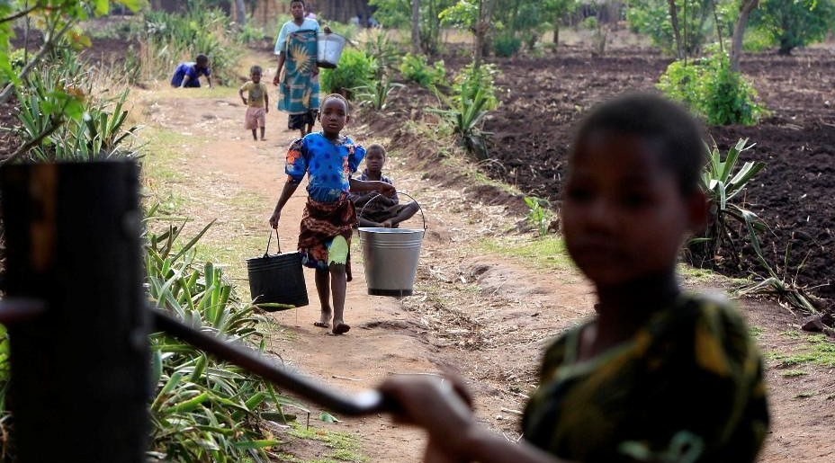
GEOGRAPHY — UPPER SIXTH ARTS
I. MEANING
Activity 1
A village water pump.
2026 / 2027
DGCAST GAROUA — GEOGRAPHY DEPARTMENT
Mr KAMDEM E. | 14
Notes:
Without the projector: list aid projects near you.

Slide 15
GEOGRAPHY — UPPER SIXTH ARTS
I. MEANING
Activity 1: Question
What is foreign aid?
2026 / 2027
DGCAST GAROUA — GEOGRAPHY DEPARTMENT
Mr KAMDEM E. | 15

Slide 16
GEOGRAPHY — UPPER SIXTH ARTS
I. MEANING
Answer
Help in money, goods or skills given by one country or organisation to another.
2026 / 2027
DGCAST GAROUA — GEOGRAPHY DEPARTMENT
Mr KAMDEM E. | 16

Slide 17
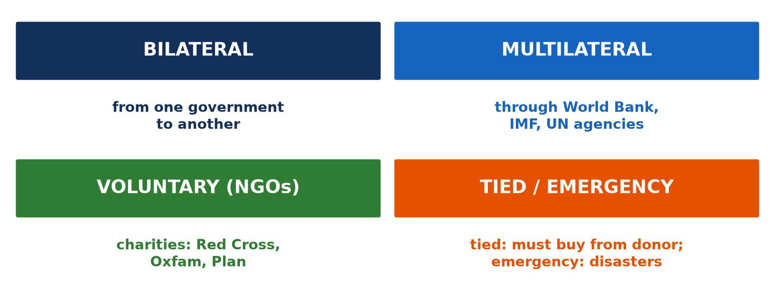
GEOGRAPHY — UPPER SIXTH ARTS
II. TYPES
Activity 2
Types of aid.
2026 / 2027
DGCAST GAROUA — GEOGRAPHY DEPARTMENT
Mr KAMDEM E. | 17
Notes:
Without the projector: read the boxes.

Slide 18
GEOGRAPHY — UPPER SIXTH ARTS
II. TYPES
Activity 2: Question
Distinguish bilateral and multilateral aid.
2026 / 2027
DGCAST GAROUA — GEOGRAPHY DEPARTMENT
Mr KAMDEM E. | 18

Slide 19
GEOGRAPHY — UPPER SIXTH ARTS
II. TYPES
Answer
Bilateral: government to government. Multilateral: through the World Bank, IMF or UN.
2026 / 2027
DGCAST GAROUA — GEOGRAPHY DEPARTMENT
Mr KAMDEM E. | 19

Slide 20

GEOGRAPHY — UPPER SIXTH ARTS
II. EMERGENCY AID
Activity 3
Food aid being unloaded.
2026 / 2027
DGCAST GAROUA — GEOGRAPHY DEPARTMENT
Mr KAMDEM E. | 20
Notes:
Without the projector: discuss food aid.

Slide 21
GEOGRAPHY — UPPER SIXTH ARTS
II. EMERGENCY AID
Activity 3: Question
When is emergency aid given?
2026 / 2027
DGCAST GAROUA — GEOGRAPHY DEPARTMENT
Mr KAMDEM E. | 21

Slide 22
GEOGRAPHY — UPPER SIXTH ARTS
II. EMERGENCY AID
Answer
After disasters like droughts, floods or wars.
2026 / 2027
DGCAST GAROUA — GEOGRAPHY DEPARTMENT
Mr KAMDEM E. | 22

Slide 23
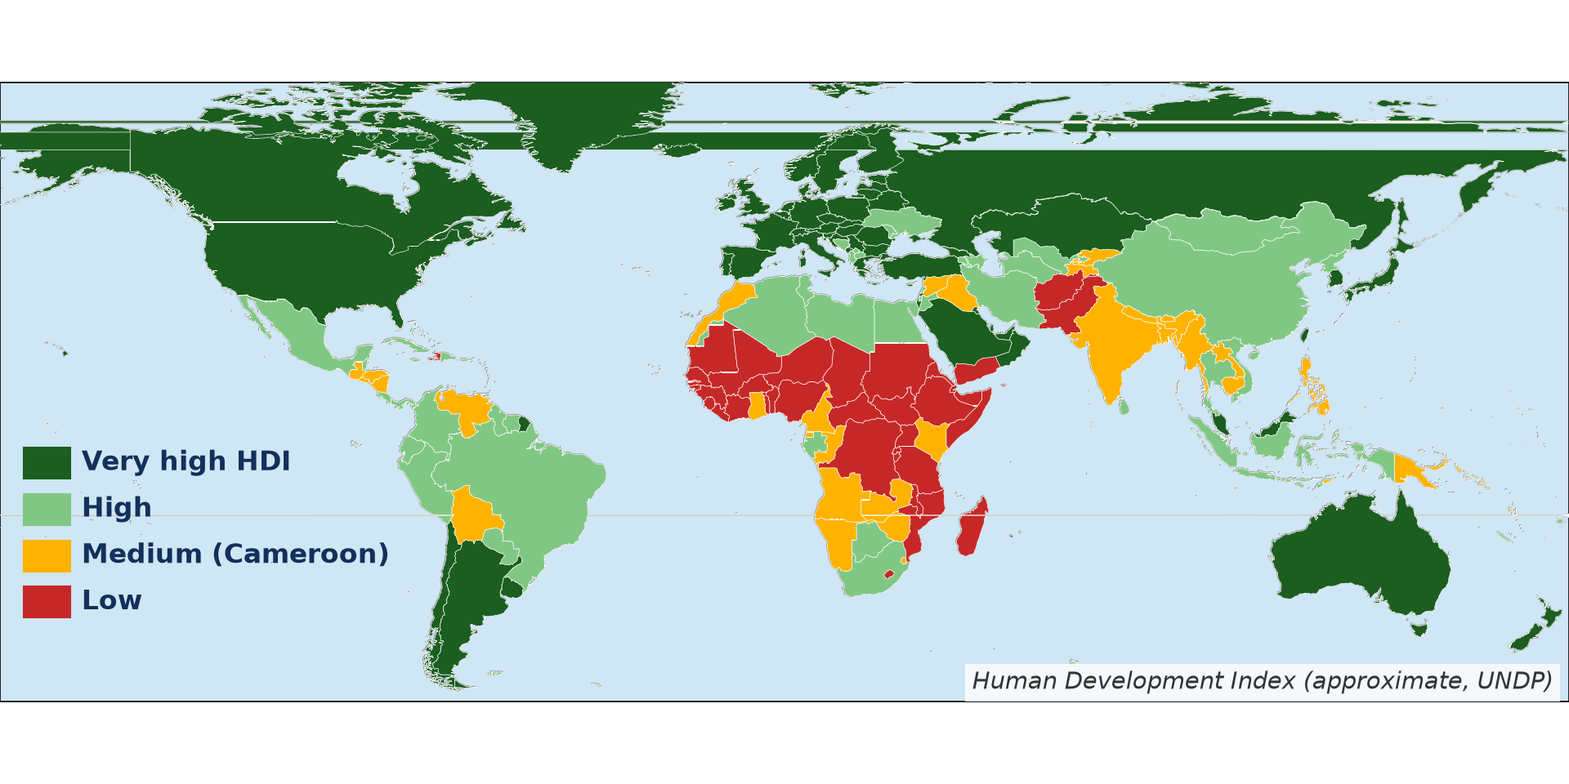
GEOGRAPHY — UPPER SIXTH ARTS
III. DONORS AND RECIPIENTS
Activity 4
Rich and poor countries (approximate HDI).
2026 / 2027
DGCAST GAROUA — GEOGRAPHY DEPARTMENT
Mr KAMDEM E. | 23
Notes:
Without the projector: read the map.

Slide 24
GEOGRAPHY — UPPER SIXTH ARTS
III. DONORS AND RECIPIENTS
Activity 4: Question
Name two donors and two recipient regions.
2026 / 2027
DGCAST GAROUA — GEOGRAPHY DEPARTMENT
Mr KAMDEM E. | 24

Slide 25
GEOGRAPHY — UPPER SIXTH ARTS
III. DONORS AND RECIPIENTS
Answer
Donors: USA, EU countries (also Japan, China). Recipients: Sub-Saharan Africa, South Asia.
2026 / 2027
DGCAST GAROUA — GEOGRAPHY DEPARTMENT
Mr KAMDEM E. | 25

Slide 26
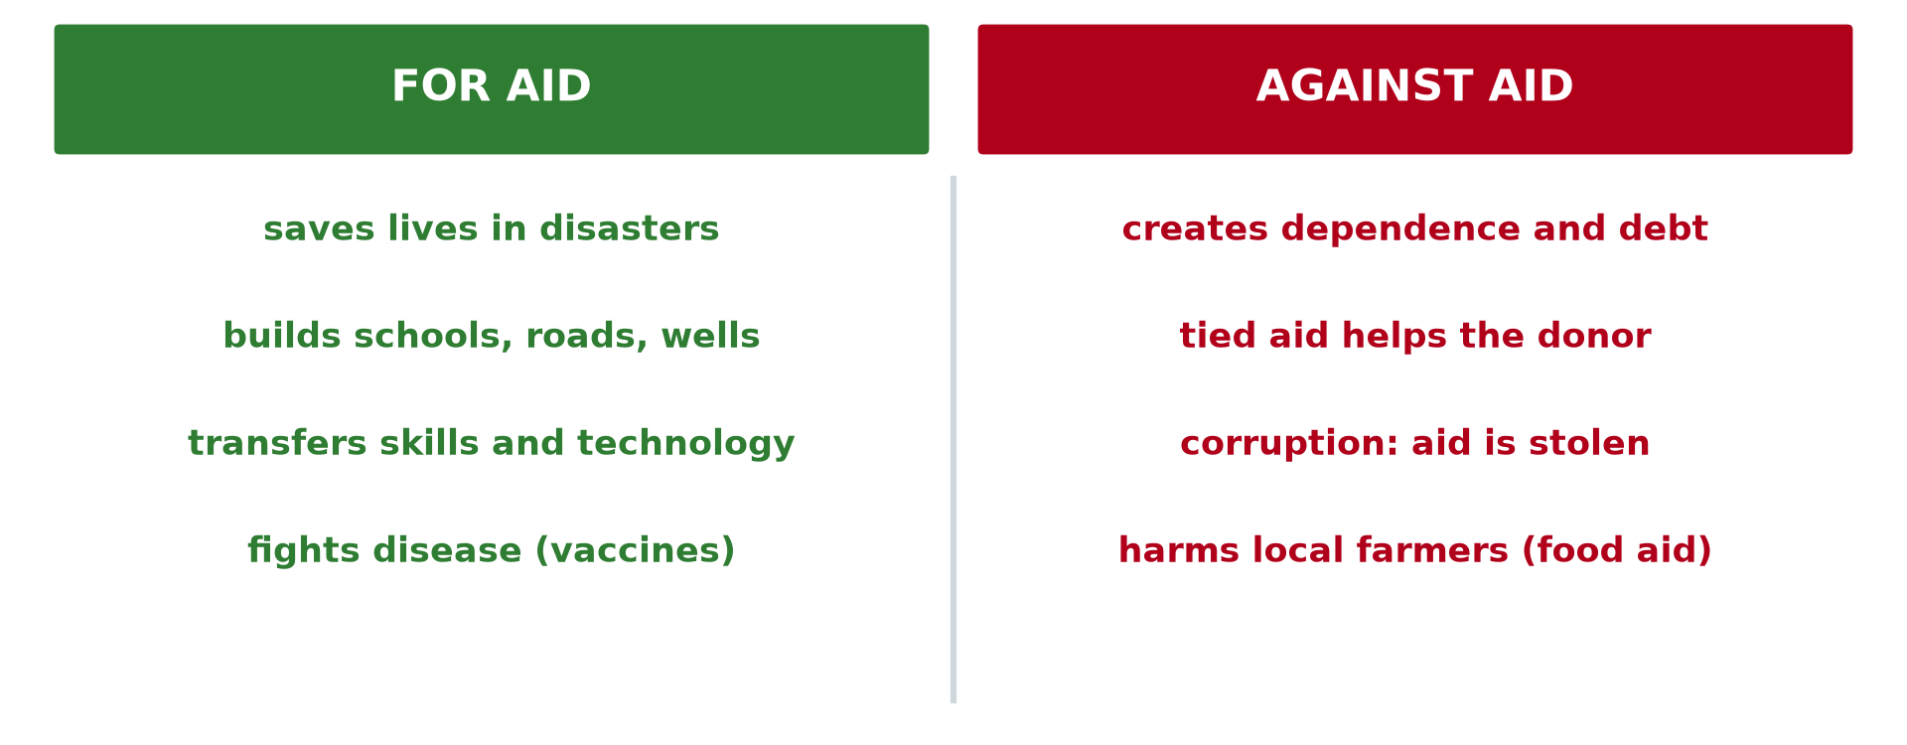
GEOGRAPHY — UPPER SIXTH ARTS
IV. APPRAISAL
Activity 5
Arguments for and against aid.
2026 / 2027
DGCAST GAROUA — GEOGRAPHY DEPARTMENT
Mr KAMDEM E. | 26
Notes:
Without the projector: debate in class.

Slide 27
GEOGRAPHY — UPPER SIXTH ARTS
IV. APPRAISAL
Activity 5: Question
Give two arguments for and two against aid.
2026 / 2027
DGCAST GAROUA — GEOGRAPHY DEPARTMENT
Mr KAMDEM E. | 27

Slide 28
GEOGRAPHY — UPPER SIXTH ARTS
IV. APPRAISAL
Answer
For: saves lives, builds schools. Against: dependence, corruption.
2026 / 2027
DGCAST GAROUA — GEOGRAPHY DEPARTMENT
Mr KAMDEM E. | 28

Slide 29
GEOGRAPHY — UPPER SIXTH ARTS
BOARD SUMMARY
Aid and Interdependence
Topic: Current Development Issues
Sub-topic: Trade and Cooperation
Lesson 14: Aid and Interdependence
2026 / 2027
DGCAST GAROUA — GEOGRAPHY DEPARTMENT
Mr KAMDEM E. | 29
Notes:
Learners copy the board summary now. Give them enough time for each slide.

Slide 30
GEOGRAPHY — UPPER SIXTH ARTS
BOARD SUMMARY
I. Definitions
Aid: It is help in money, goods or skills given to a country or people in need.
Tied aid: It is aid that must be spent on goods from the donor country.
Interdependence: It is the dependence of countries on one another.
2026 / 2027
DGCAST GAROUA — GEOGRAPHY DEPARTMENT
Mr KAMDEM E. | 30

Slide 31
GEOGRAPHY — UPPER SIXTH ARTS
BOARD SUMMARY
II. Types, Donors and Recipients (1/3)
A. Official aid: Bilateral aid goes from one government to another. Multilateral aid goes through the World Bank, IMF and UN.
B. Voluntary aid: NGOs like the Red Cross and Plan give aid from private gifts. Aid can be direct (projects) or indirect (loans, training).
2026 / 2027
DGCAST GAROUA — GEOGRAPHY DEPARTMENT
Mr KAMDEM E. | 31

Slide 32
GEOGRAPHY — UPPER SIXTH ARTS
BOARD SUMMARY
II. Types, Donors and Recipients (2/3)
C. Donors and recipients: The USA, EU countries, Japan and China are big donors. Sub-Saharan Africa and South Asia receive the most.
2026 / 2027
DGCAST GAROUA — GEOGRAPHY DEPARTMENT
Mr KAMDEM E. | 32

Slide 33
GEOGRAPHY — UPPER SIXTH ARTS
BOARD SUMMARY
II. Types, Donors and Recipients (3/3)
Copy the types.
2026 / 2027
DGCAST GAROUA — GEOGRAPHY DEPARTMENT
Mr KAMDEM E. | 33

Slide 34
GEOGRAPHY — UPPER SIXTH ARTS
BOARD SUMMARY
III. Appraisal
A. For aid: Aid saves lives in disasters and builds schools, clinics and wells. It transfers skills and technology.
B. Against aid: Aid can create debt and dependence and may be stolen. Tied aid and food aid can harm local producers.
2026 / 2027
DGCAST GAROUA — GEOGRAPHY DEPARTMENT
Mr KAMDEM E. | 34

Slide 35
GEOGRAPHY — UPPER SIXTH ARTS
FORMATIVE EVALUATION
Formative Evaluation 1
Give three types of aid with examples.
2026 / 2027
DGCAST GAROUA — GEOGRAPHY DEPARTMENT
Mr KAMDEM E. | 35

Slide 36
GEOGRAPHY — UPPER SIXTH ARTS
FORMATIVE EVALUATION
Expected Answer
Bilateral (France to Cameroon), multilateral (World Bank), voluntary (Red Cross).
2026 / 2027
DGCAST GAROUA — GEOGRAPHY DEPARTMENT
Mr KAMDEM E. | 36

Slide 37
GEOGRAPHY — UPPER SIXTH ARTS
FORMATIVE EVALUATION
Formative Evaluation 2
Give two advantages and two disadvantages of aid.
2026 / 2027
DGCAST GAROUA — GEOGRAPHY DEPARTMENT
Mr KAMDEM E. | 37

Slide 38
GEOGRAPHY — UPPER SIXTH ARTS
FORMATIVE EVALUATION
Expected Answer
Advantages: saves lives, builds services. Disadvantages: dependence, corruption.
2026 / 2027
DGCAST GAROUA — GEOGRAPHY DEPARTMENT
Mr KAMDEM E. | 38

Slide 39
GEOGRAPHY — UPPER SIXTH ARTS
REMEDIATION
Remediation
Fill in the blanks:
Aid between two governments is ______.
Charities are ______.
Aid spent in the donor country is ______ aid.
2026 / 2027
DGCAST GAROUA — GEOGRAPHY DEPARTMENT
Mr KAMDEM E. | 39
Notes:
Answers: 1. bilateral 2. NGOs 3. tied

Slide 40
GEOGRAPHY — UPPER SIXTH ARTS
HOMEWORK
Homework
Find an aid project in your region and write who funds it and what it does.
This prepares Further Study 1: Contrast in Development within Cameroon.
2026 / 2027
DGCAST GAROUA — GEOGRAPHY DEPARTMENT
Mr KAMDEM E. | 40
Notes:
This homework prepares the next lesson.

Slide 41
GEOGRAPHY — UPPER SIXTH ARTS
BILINGUAL GAME
Bilingual Game (Jeu Bilingue)
English | Français
Aid | L'aide
Donor | Le donateur
Loan | Le prêt
Debt | La dette
Charity | L'organisation caritative
Dependence | La dépendance
2026 / 2027
DGCAST GAROUA — GEOGRAPHY DEPARTMENT
Mr KAMDEM E. | 41
Notes:
Say the English word; learners give the French word, then the reverse.

Slide 42
GEOGRAPHY — UPPER SIXTH ARTS
LOGBOOK
Official Logbook (1/2)
Module / Topic | Current Development Issues
Lesson Title | Lesson 14: Aid and Interdependence
Expected Learning Outcomes | Define aid and classify its types. Identify donors and recipients. Evaluate arguments for and against aid.
Competence | Learners are able to classify aid and evaluate its effects.
2026 / 2027
DGCAST GAROUA — GEOGRAPHY DEPARTMENT
Mr KAMDEM E. | 42

Slide 43
GEOGRAPHY — UPPER SIXTH ARTS
LOGBOOK
Official Logbook (2/2)
Matter Taught | I. Definitions: Aid, Tied aid, Interdependence; II. Types, Donors and Recipients: Official aid, Voluntary aid, Donors and recipients; III. Appraisal: For aid, Against aid.
Evaluation | Formative evaluation (3 questions) and remediation exercise.
Homework | Find an aid project in your region and write who funds it and what it does.
Enrolment / Present / Absent | ____ / ____ / ____
Achievement | To be completed by the teacher after the lesson.
2026 / 2027
DGCAST GAROUA — GEOGRAPHY DEPARTMENT
Mr KAMDEM E. | 43

Slide 44
GEOGRAPHY — UPPER SIXTH ARTS
TEACHER'S NOTE
Teacher's Note
Timing: Set-up, recall 8 min | Situation 8 min | 5 activities 30 min | Board summary (copying) 30 min | Evaluation, remediation 10 min | Homework, logbook 9 min | Spare 5 min
2026 / 2027
DGCAST GAROUA — GEOGRAPHY DEPARTMENT
Mr KAMDEM E. | 44

Slide 45
GEOGRAPHY — UPPER SIXTH ARTS
REFERENCES
References
National Geography Syllabus, Sixth Forms (Lower & Upper Sixth), MINESEC/IGE/IP-SS, August 2019 — Module 7 (Environment and Development).
Photo, Activity 1: “Girls from the village of Mwachilolo head to the Pump Aid Elephant wat” by PumpAid, CC BY 2.0, via Flickr (https://www.flickr.com/photos/84463652@N06/8161357208)
Photo, Activity 3: “WFP food distribution” by UNAMID Photo, CC BY-NC-ND 2.0, via Flickr (https://www.flickr.com/photos/58538810@N03/12495227734)
Diagrams and animations: drawn for this lesson (DGCAST Geography Department).
2026 / 2027
DGCAST GAROUA — GEOGRAPHY DEPARTMENT
Mr KAMDEM E. | 45

